Slide 1
CIS 591 - Group D5
Sentiment Analysis for Starbucks

Slide 2
Team - Group D5
Sagar Mange
Aadish Newrekar
Himanshu Saratkar
Shruti Nair
Abhigyan Singh
Shubham Sahakari

Slide 3
Contents
01
Company Info
02
Business Problem
Facts about Starbucks you need to know
Description of the business process, the business question
03
Why Starbucks
04
About the Data
Reasoning behind the choice of company
About the data we used, how we collected and how we used it
05
The Analysis
06
Visualized analysis
The operations and steps performed to get meaningful insights
Charts to make it easy for interpretation using BI tools
07
Interpretations
08
Improvements
What have we interpreted so far?
Our recommendations for potential improvements

Slide 4

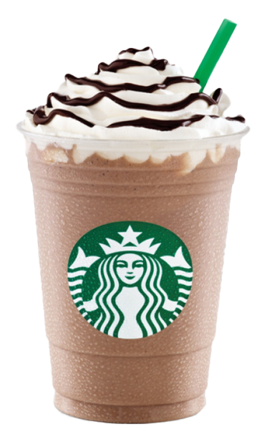

About Starbucks
Starbucks is an American multinational chain of coffee houses and roastery reserves that was founded in Seattle, Washington in 1971
Vast number of stores across 80+ countries, serving high-quality products and services that have earned it a loyal customer base.

Slide 5
Why did we choose Starbucks?
Starbucks is a globally recognized brand with a large and loyal customer base, making it an ideal candidate for analyzing customer sentiments towards a new product.
It provides an excellent opportunity to apply sentimental analysis and topic modeling techniques to social media data, in order to gain insights into customer preferences and inform future product development.

Slide 6
Business process involved
Informed decision-making processes related to product development and customer satisfaction on new launches at Starbucks.

Slide 7
Business Questions?
01
Deciding whether to continue or discontinue a the new Oleoto drink based on customer feedback and sentiment analysis on Reddit.
02
Identifying the top-selling drinks and ingredients at Starbucks in order to inform product development and marketing strategies.

Slide 8
Ways of Data Collection
Typically…
Using Reddit…
…from customer feedback
Variety of channels, such as customer surveys, social media monitoring, and sales data analysis
Starbucks loyalty program, the Starbucks Rewards program
…allows to gather real-time and latest feedback on the new Oleoto drink
Allows us to tap into a diverse & highly engaged community of coffee lovers
Provides unfiltered reactions from the customers.

Slide 9
Data retrieval from Reddit
Used the Reddit API, PRAW (Python Reddit API Wrapper), to retrieve data from relevant subreddits
and threads related to Starbucks and its products
over a period of time.
r/oleato
r/starbucks
r/starbucksbarista
r/coffee
r/coffee_shop
r/coffeeroasters
r/coffeestations
We collected real-time data over a period of 2-3 week.

Slide 10
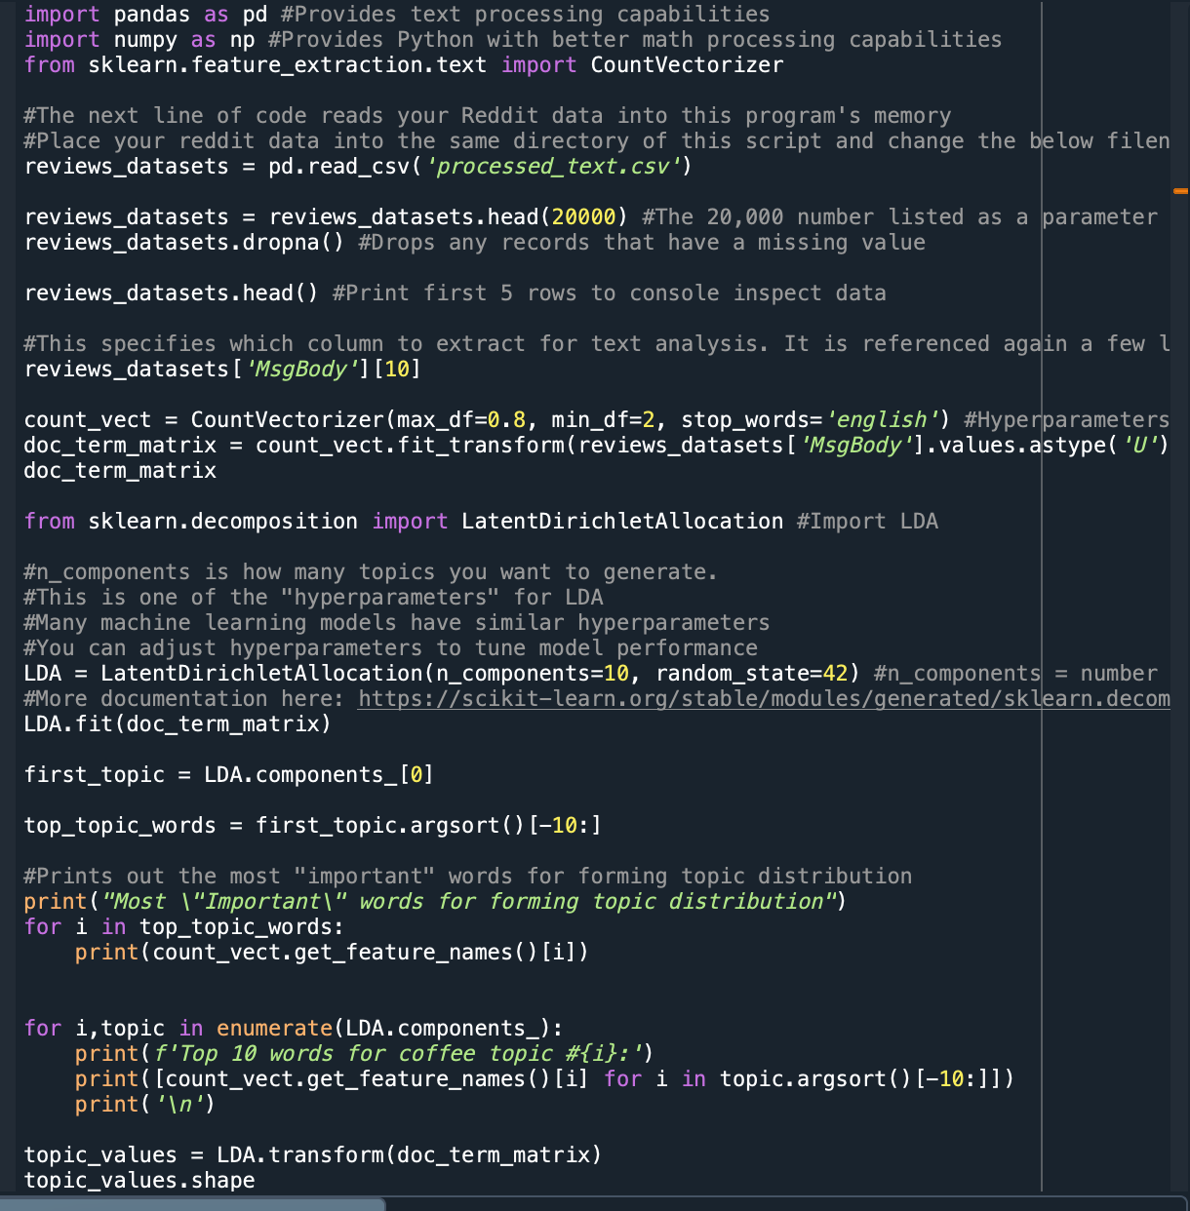
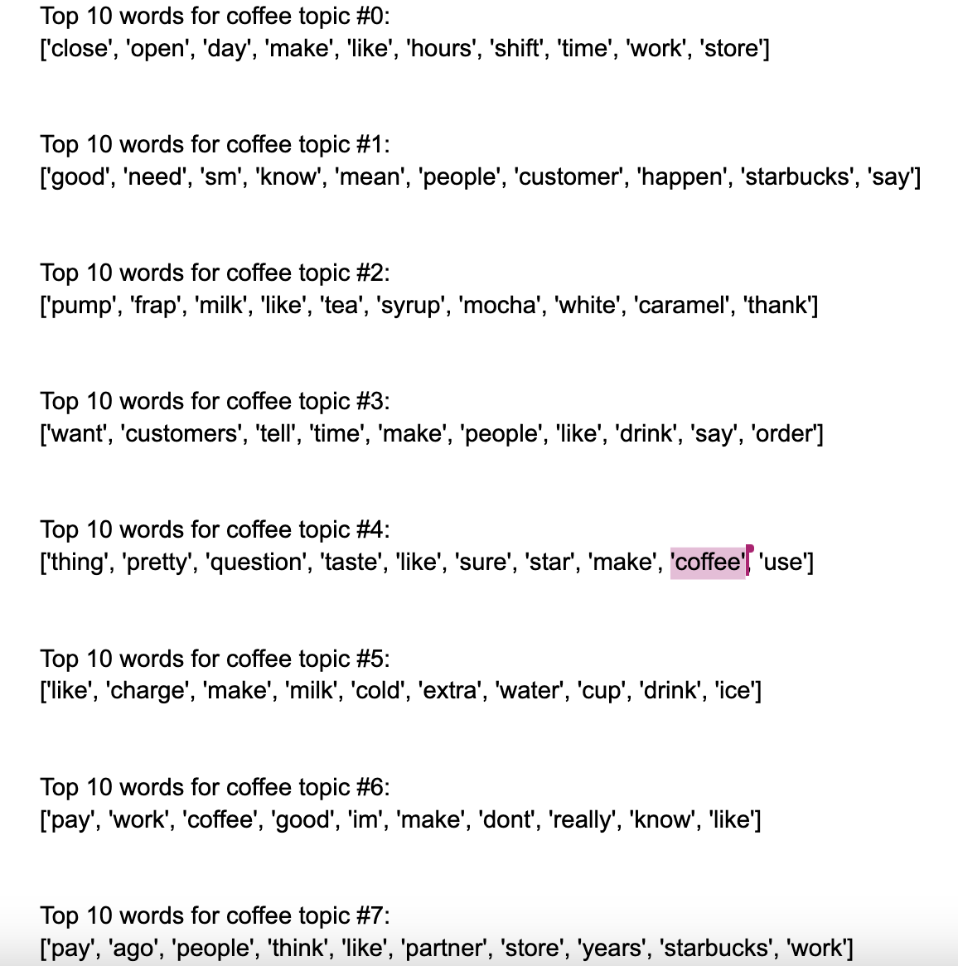
LDA code
Output:

Slide 11
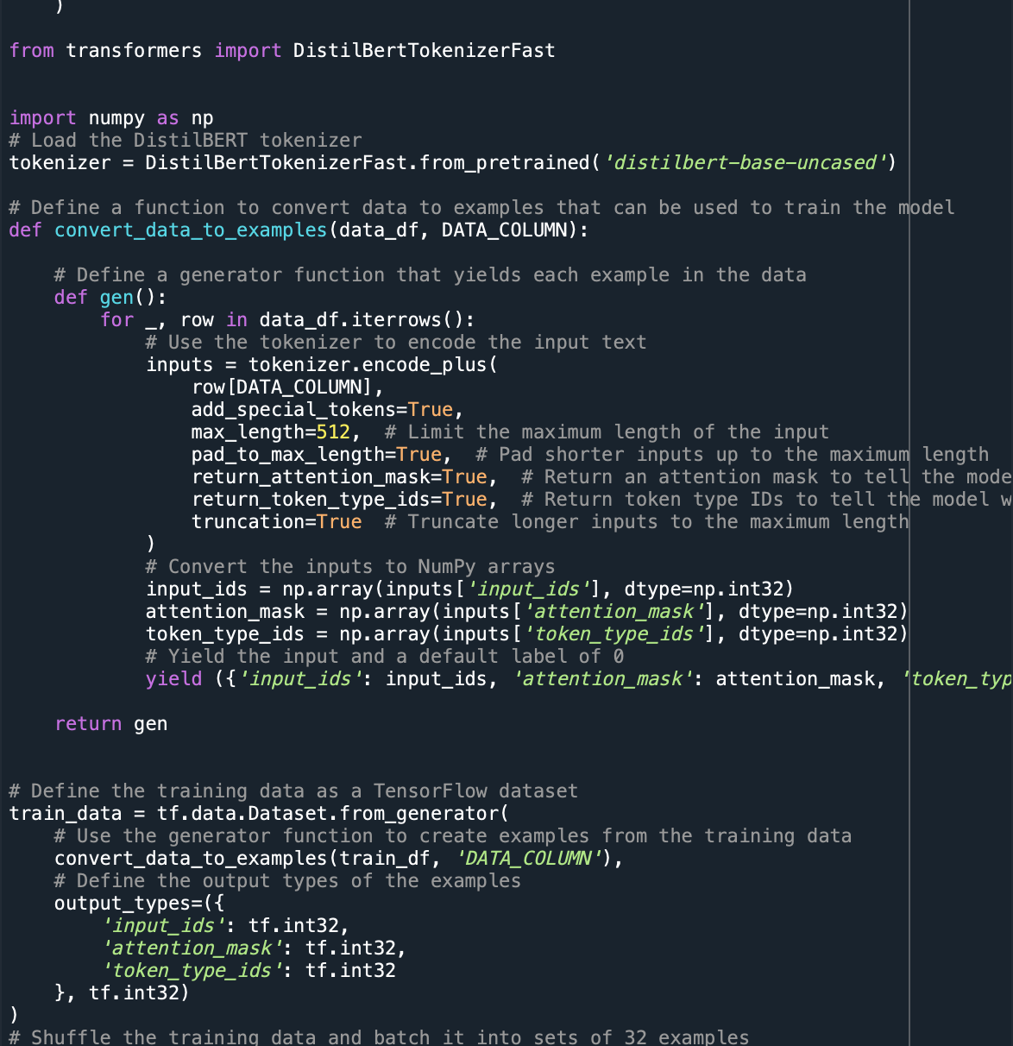
Fine-tuning the BERT model w.r.t. our dataset

Slide 12
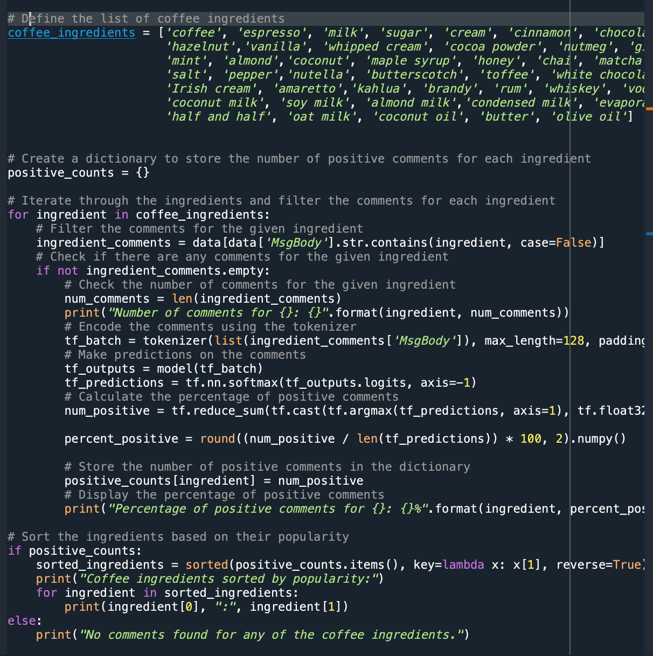
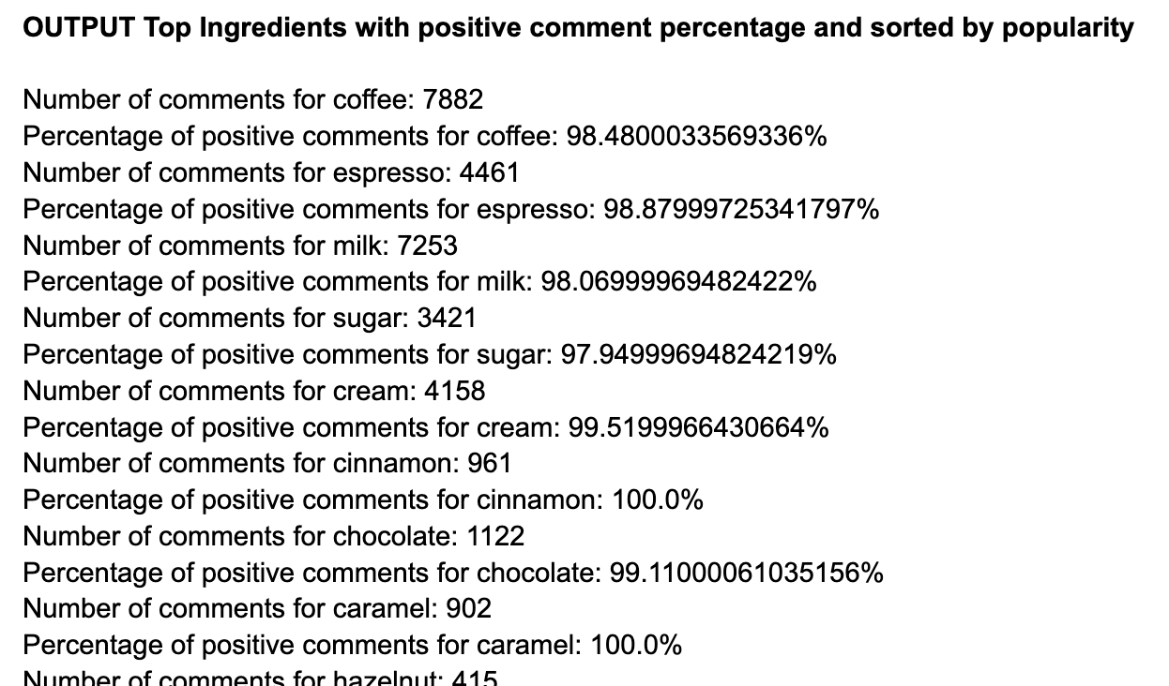
Code for Top Ingredients with positive comment percentage and sorted by popularity
Output:

Slide 13
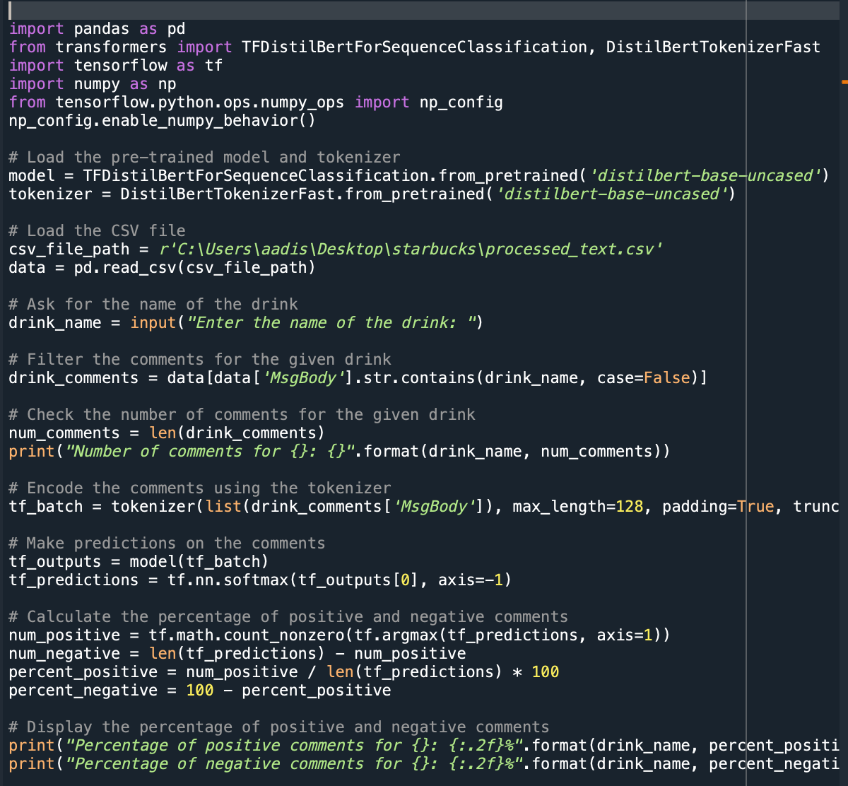
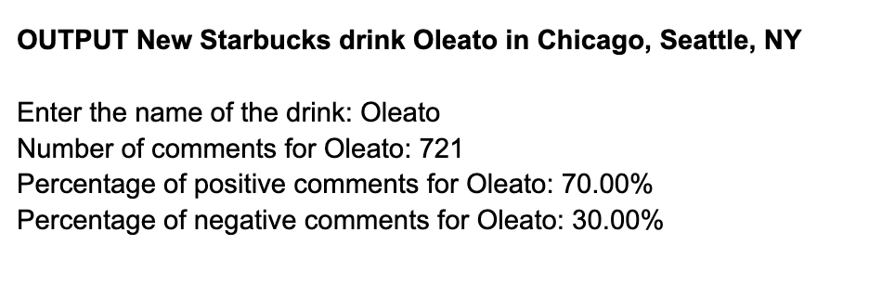
Code for New Starbucks drink Oleato in Chicago, Seattle, NY
Output:

Slide 14

Our Top 5 drinks
Cappuccino
Espresso
Doppio
Americano
Espresso
Milk Foam
Hot Chocolate
Steamed Milk
Hot Water
Latte
Mocha

Slide 15
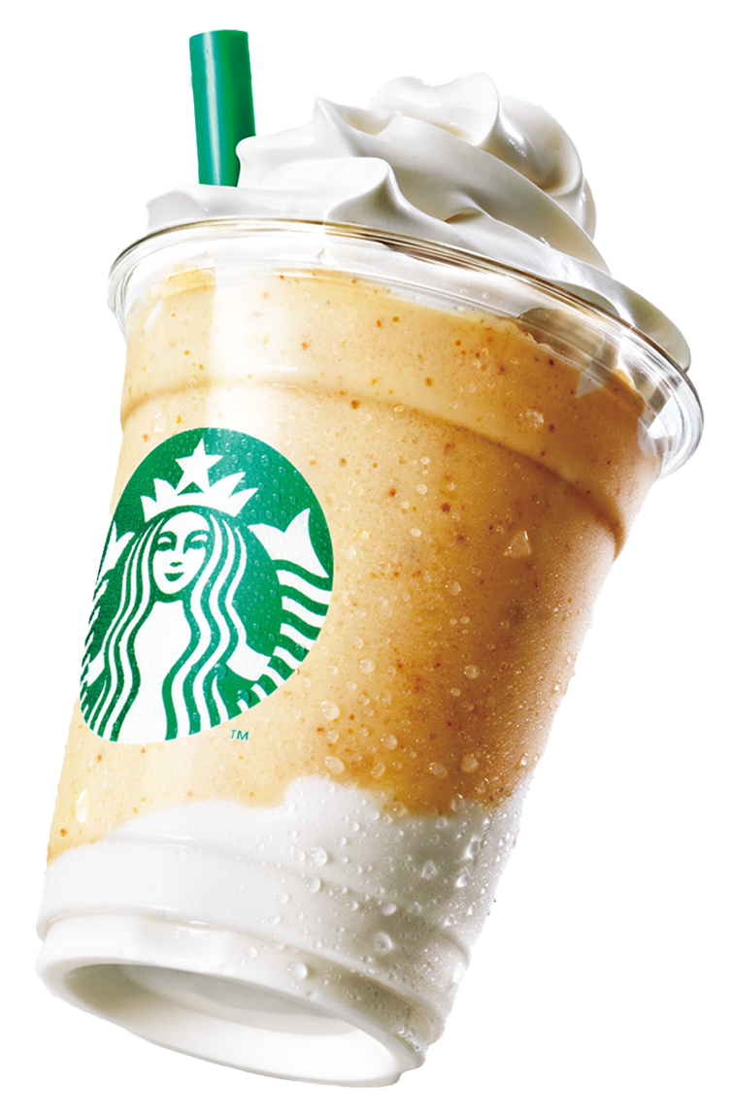
Our Top 10 ingredients (top to bottom)
Coffee
Milk
Espresso
Cream
Vanilla
Caramel
…across all sizes
Matcha
Chai
Chocolate
Short
Medium
Large
Cinnamon

Slide 16
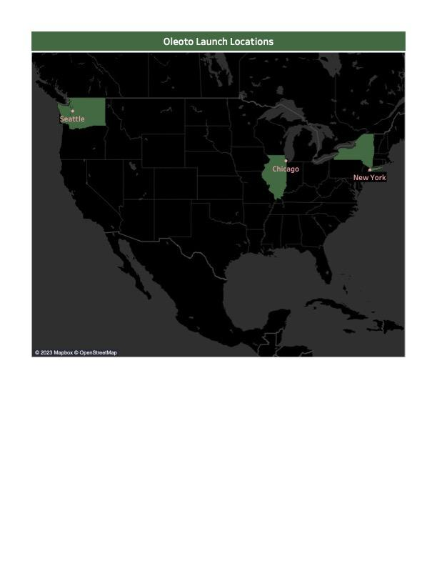
Locations where Oleato is launched in the US
Seattle
Chicago
New York

Slide 17
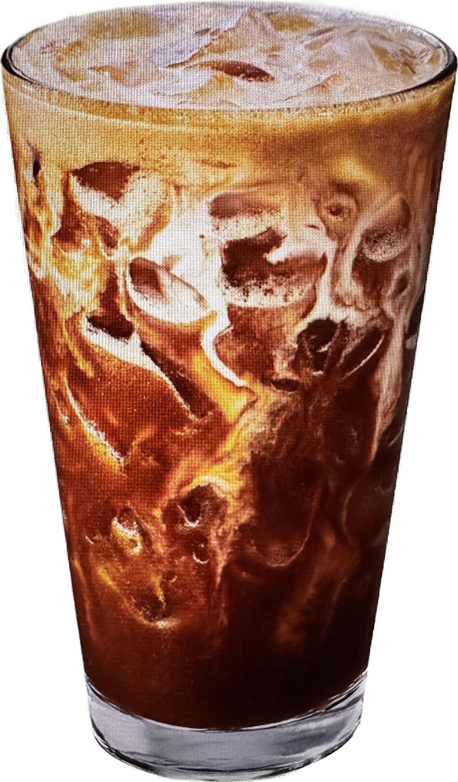
Our recommendation on Oleoto?
After our analysis, the percentage positive response received was about 70% from the selected locations.
Overall, this score is a good estimate for the drinks success.
Thus, we recommend Starbucks to continue their latest olive oil-based drink and potentially launch in all other locations worldwide.

Slide 18

It’s not just coffee, it’s Starbucks
Thank You

